Slide 1

Algebra 1
Unit 13, Lesson 2 Compound Interest Volume 2, pg. 241

Slide 2


Benchmarks
MA.912.FL.3.2
Solve real-world problems involving simple, compound, and continuously compounded interest.
MA.912.FL.3.4
Explain the relationship between simple interest and linear growth. Explain the relationship between compound interest and exponential growth, and the relationship between continuously compounded interest and exponential growth.
MA.912.F.1.8
Determine whether a linear, quadratic, or exponential function best models a given real-world situation.
volume 2, pg. 241

Slide 3
Integrated Mathematical Thinking and Reasoning Standards
MA.K12.MTR.2.1 Demonstrate understanding by representing problems in multiple ways.
MA.K12.MTR.4.1 Engage in discussions that reflect on the mathematical thinking of self and others.
MA.K12.MTR.5.1 Use patterns and structure to help understand and connect mathematical concepts.
MA.K12.MTR.6.1 Assess the reasonableness of solutions.
MA.K12.MTR.7.1 Apply mathematics to real-world contexts.
volume 2, pg. 241

Slide 4

Learning Targets
I can explain the relationship between compound interest and exponential growth.
I can solve real-world problems involving compound interest.
I can compare simple interest growth and compound interest growth.
volume 2, pg. 241

Slide 5

Warm-Up
volume 2, pg. 241

Slide 6
13.2.1 Warm-Up: Paramedic
Kelly Grayson is an emergency medical technician (EMT). In an interview, she was asked, “How do you stay focused and deal with the crisis situation to solve the problem at hand when responding to an emergency call?” Kelly Grayson replied, “You focus on process and fall back on your training.”
How does staying focused on the process and falling back on your prior training help you in difficult situations?
What is one thing you have done to help you when learning difficult concepts in mathematics?
volume 2, pg. 241

Slide 7

Collaboration
volume 2, pg. 242

Slide 8

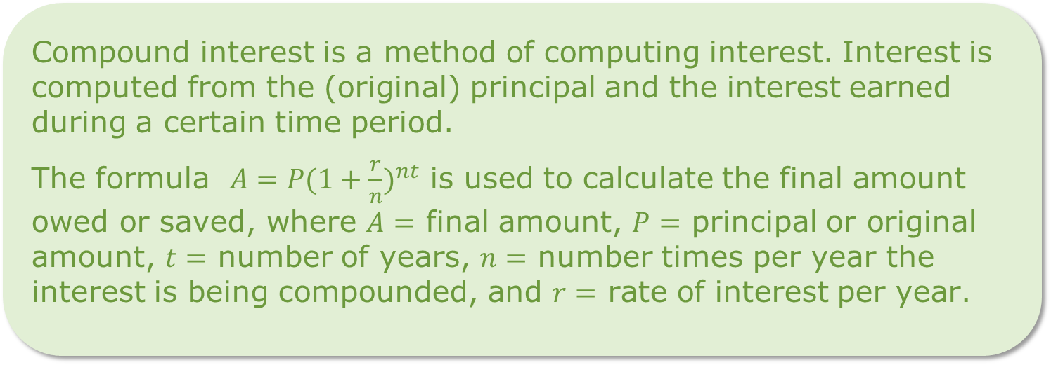
13.2.2 Collaboration: Understanding Compound Interest
Compound interest is a method of computing interest. Interest is computed from the (original) principal and the interest earned during a certain time period.
The formula $A=P(1+{\frac{r}{n})}^{nt}$ is used to calculate the final amount owed or saved, where $A=$ final amount, $P=$ principal or original amount, $t=$ number of years, $n=$ number times per year the interest is being compounded, and $r=$ rate of interest per year.
volume 2, pg. 242

Slide 9
When money is invested, compound interest means that interest is being accrued based on both the principal and previous interest earned.
When money is owed, such as a credit card bill, compound interest means that interest is owed based on both the principal and previous interest accrued.
volume 2, pg. 242

Slide 10
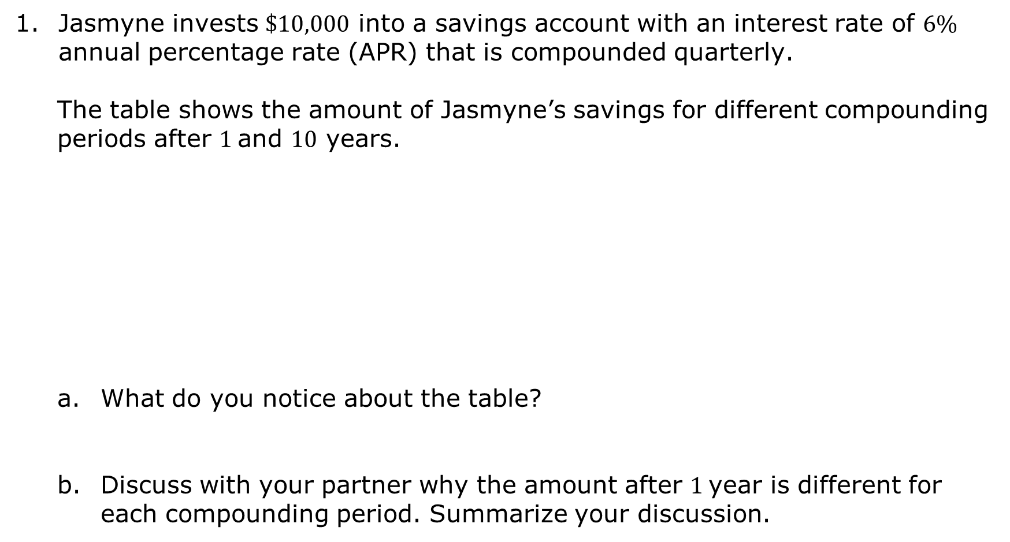
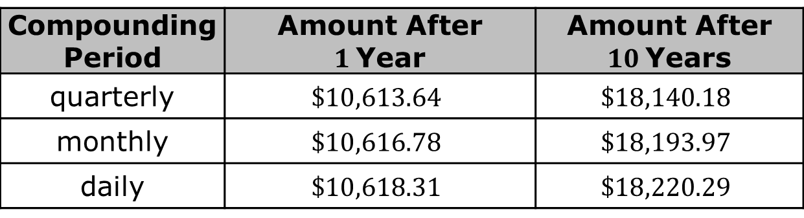
Jasmyne invests $\$10,000$ into a savings account with an interest rate of $6\%$ annual percentage rate (APR) that is compounded quarterly.
The table shows the amount of Jasmyne’s savings for different compounding periods after $1$and $10$ years.
What do you notice about the table?
Discuss with your partner why the amount after $1$year is different for each compounding period. Summarize your discussion.
Compounding Period | Amount After $1$Year | Amount After $10$Years
quarterly | $$\$10,613.64$$ | $$\$18,140.18$$
monthly | $$\$10,616.78$$ | $$\$18,193.97$$
daily | $$\$10,618.31$$ | $$\$18,220.29$$
volume 2, pg. 242

Slide 11
Work with your partner to explain why compound interest for investments, such as savings accounts or certificates of deposits (CD), are better than simple interest.
Work with your partner to explain why compound interest for loans, such as a car loan, is not better than simple interest.
volume 2, pg. 243

Slide 12

Guided Instruction
volume 2, pg. 243

Slide 13
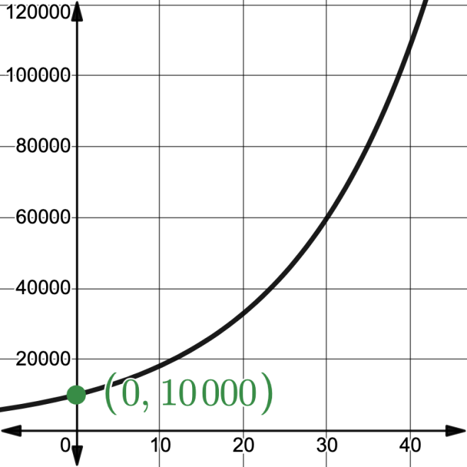
13.2.3 Guided Instruction: Compound Interest
The graph shows an initial investment of $\$10,000$ in a savings account. The interest rate is $6\%$ compounded quarterly.
volume 2, pg. 243

Slide 14
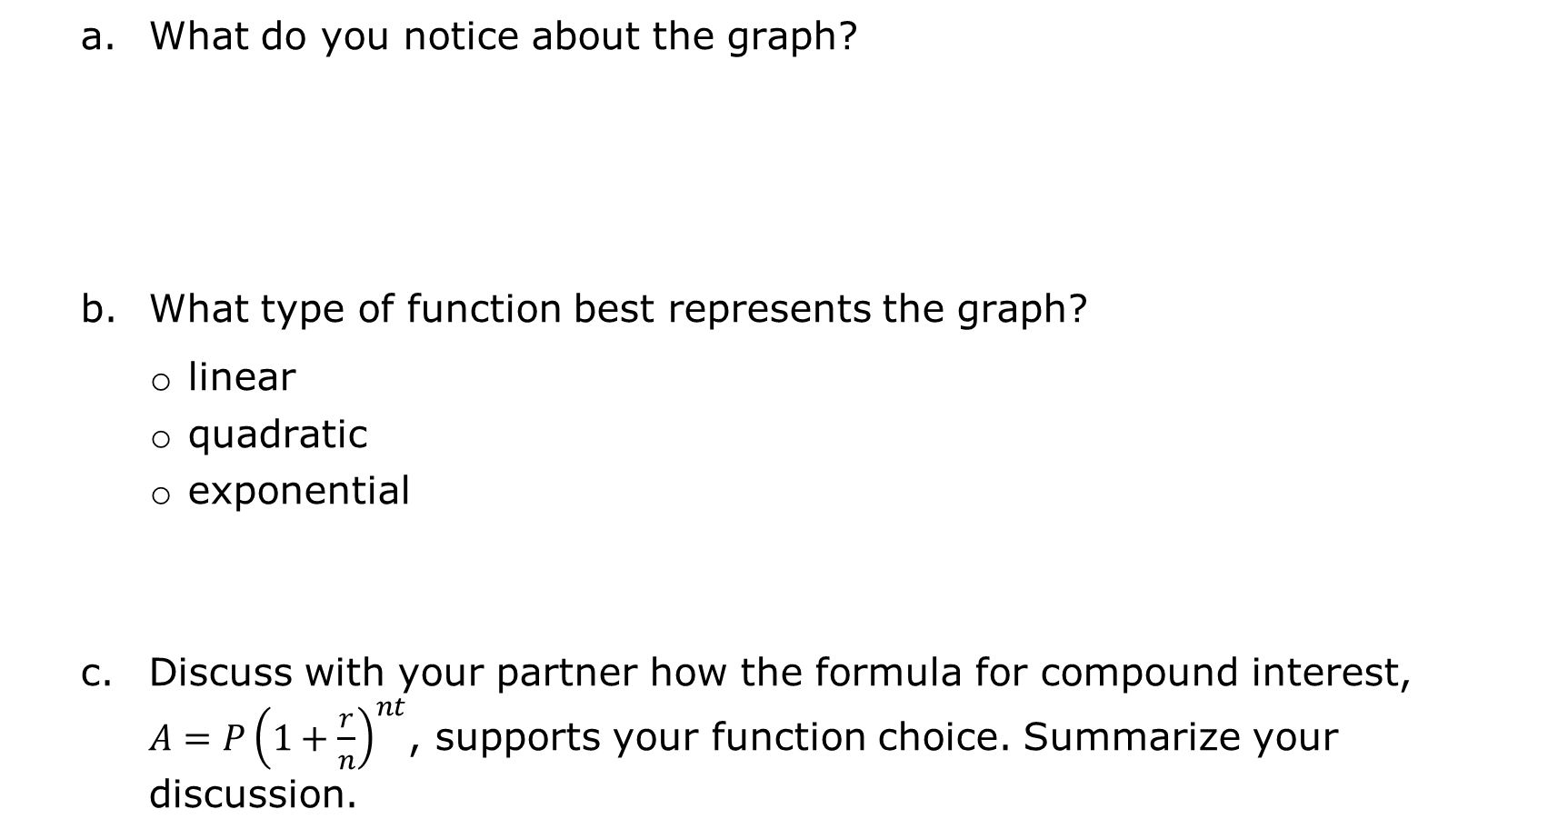
What do you notice about the graph?
What type of function best represents the graph?
linear
quadratic
exponential
Discuss with your partner how the formula for compound interest, $A=P{\left(1+\frac{r}{n}\right)}^{nt}$, supports your function choice. Summarize your discussion.
volume 2, pg. 243

Slide 15
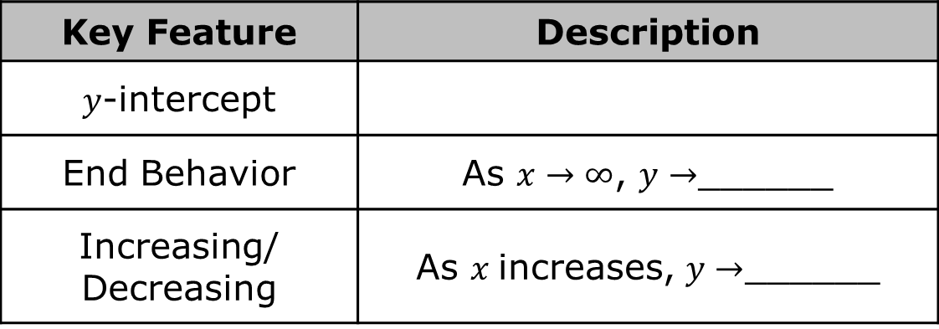

Complete the table.
Use the information about the graph to write an equation that models the relationship.
What is the balance of the savings account after $7$years?
Key Feature | Description
$y$-intercept
End Behavior | As $x→∞$, $y→$______
Increasing/ Decreasing | As $x$increases, $y→$______
volume 2, pg. 244

Slide 16
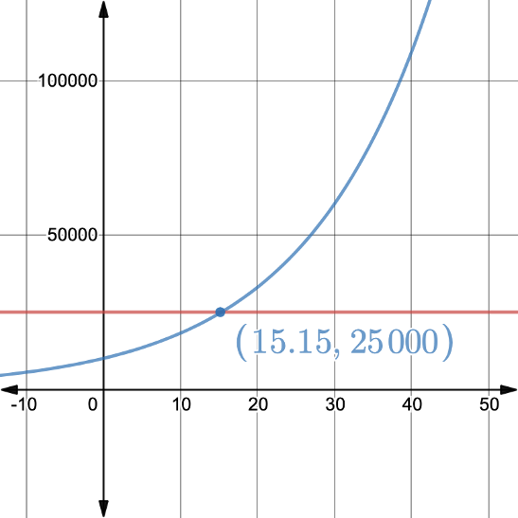
Use the graph shown to determine when the savings account will reach $\$25,000$.
volume 2, pg. 244

Slide 17
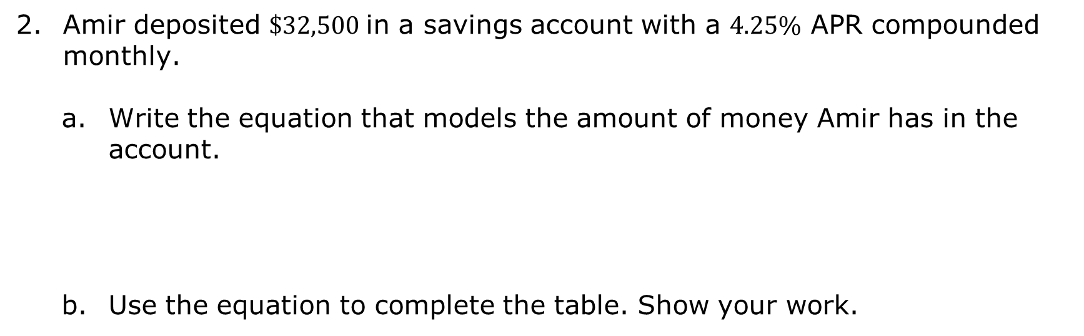
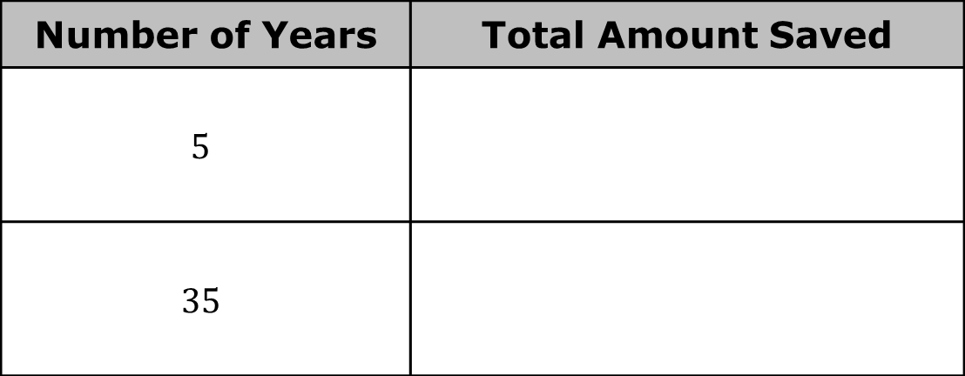
Amir deposited $\$32,500$in a savings account with a $4.25\%$ APR compounded monthly.
Write the equation that models the amount of money Amir has in the account.
Use the equation to complete the table. Show your work.
Number of Years | Total Amount Saved
$$5$$
$$35$$
volume 2, pg. 245

Slide 18
Discuss with your partner the relationship between compound interest and exponential growth. Summarize your discussion.
volume 2, pg. 245

Slide 19
Collaboration
volume 2, pg. 245

Slide 20
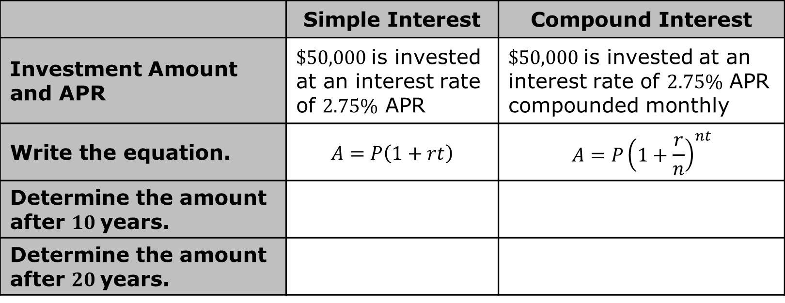
13.2.4 Collaboration: Comparing Interest
Work with your partner to complete the table to compare two investments.
 | Simple Interest | Compound Interest
Investment Amount and APR | $\$50,000$is invested at an interest rate of $2.75\%$ APR | $\$50,000$is invested at an interest rate of $2.75\%$ APR compounded monthly
Write the equation. | $$A=P\left(1+rt\right)$$ | $$A=P{\left(1+\frac{r}{n}\right)}^{nt}$$
Determine the amount after $10$years.
Determine the amount after $20$years.
volume 2, pg. 245

Slide 21

Wrap-Up
volume 2, pg. 246

Slide 22
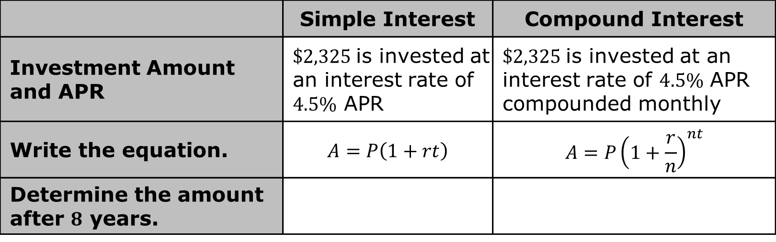
13.2.5 Wrap-Up: Ticket Out the Door
Complete the table to compare two investments.
 | Simple Interest | Compound Interest
Investment Amount and APR | $\$2,325$is invested at an interest rate of $4.5\%$ APR | $\$2,325$is invested at an interest rate of $4.5\%$ APR compounded monthly
Write the equation. | $$A=P\left(1+rt\right)$$ | $$A=P{\left(1+\frac{r}{n}\right)}^{nt}$$
Determine the amount after $8$ years.
volume 2, pg. 246

